Slide 1



REINVIGORATING BLACKBERRY
Student Names:
Course Code:
Instructor’s Name:
Date:

Slide 2


COLORS, FONTS, AND BRAND GUIDELINES
Colors, Fonts, and Brand Guidelines
  Primary Colors:
    Black (#000000) – Represents security and legacy heritage
    Magenta (#E01A72) – BlackBerry official accent
    White (#FFFFFF) – Clean and modern background
  Fonts:
    Title & Headings: Montserrat
    Body Text: Open Sans
    Consistency: Use bold for emphasis, avoid decorative fonts
  Brand Guidelines:
    Minimal, balanced slides
    High-quality visuals
    Clear hierarchy of text

Slide 3


TABLE OF CONTENT
  Project Brief
  Project Objective
  Goal
  Chosen Company + Hypothesis
  User Pain…
  Strategic Position
  Porter’s Five Forces
  Blue Ocean ERRC
  STP + TAM/SAM/SOM
  Core Value
  Future State
  Draft Approach
  References

Slide 4
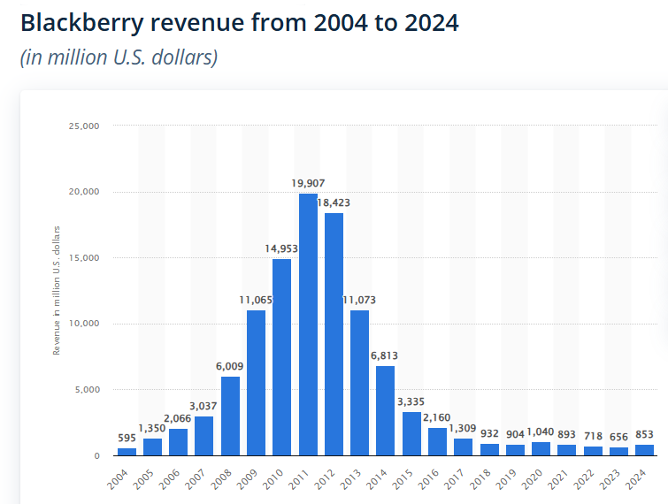
PROJECT BRIEF
BlackBerry used to be a leader in mobile communication technology, in which it controlled the smartphone market through secure messaging and physical keyboards. It had a massive market share around 2011, and it could not adjust to touchscreen innovation and evolving consumer requirements (Statista, 2026). This made the market value and relevance of BlackBerry crash drastically. It no longer manufactures phones and has moved on to cybersecurity and software services, but its financial performance is poor in comparison to the peers. To stay alive and prosper, BlackBerry should be able to reinvent its brand and resonate with the current generation (SunStar, 2024).

Slide 5

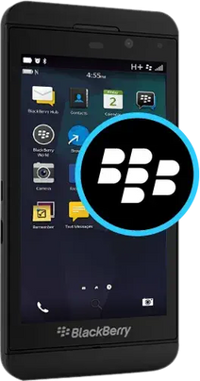
PROJECT OBJECTIVE
To analyse the downfall of BlackBerry and find a new opportunity avenue that would fit into its strength. Our objective is to establish a reinvention programme that makes BlackBerry a new brand worth believing in once more, a brand that can be used by digital users but whose security background will be used to its advantage.

Slide 6

GOAL
The goal is to rebrand BlackBerry within the circumstances of mobile lifestyle and concentrate on privacy, control, and digital wellbeing. Users who are tired of being bombarded by data tracking, numerous notifications, and addictive app ecosystems will use the brand.

Slide 7
CHOSEN COMPANY + HYPOTHESIS
Company: BlackBerry Limited
BlackBerry used to be a mobile phone empire but is currently specialized in enterprise and (connected device) software cybersecurity and software (Reuters, 2025). The recent revenue forecasts indicate its vulnerability and reduces demand in the traditional enterprise cybersecurity services (Statista, 2025).
Hypothesis:
If BlackBerry introduces a privacy-focused, minimal mobile device aimed at digitally fatigued professionals and students, it will be able to build a defensible niche segment and create recurring revenues due to the built-in hardware and subscription services (Youssef Haj Youssef, 2013).

Slide 8
The Modern Digital Stress Ecosystem
Notification Systems → constant alerts → attention fragmentation
Digital stress is not defined by a single factor but by a systemic network of notifications, algorithms and constant connectivity – which is becoming a connecting cause of research between attention fragmentation and symptoms of ADHD. (Grieva et al., 2025).
This environment creates an opportunity for a technology brand positioned around privacy, focus, and controlled communication.
Social Media Platforms → endless feeds → addictive usage
Data Tracking & Algorithms → behavior monitoring → privacy anxiety
Modern Smartphone User
Average smartphone users check their phone 90–100 times per day (Asurion, 2024).
Global average screen time exceeds 6–7 hours daily (Kaewpradit, 2025).
According to Winter (2024), heavy digital media use is associated with higher ADHD-related symptoms in adolescents (JAMA Pediatrics).
App Ecosystems → multitasking → cognitive overload
Work & Academic Expectations → always reachable → pressure

Slide 9
Daily Digital Interaction Journey
Phase | User Activity | Cognitive State | System Influence | Opportunity Insight
Morning | Checks phone immediately | Alert but distracted | Notifications & feeds | Need for controlled notification intake
Midday | Work/study communication | Fragmented focus (Reuters, 2025) | App multitasking | Opportunity for focus-oriented interface
Afternoon | Passive scrolling | Reduced productivity | Algorithmic loops | Need for intentional-use design
Evening | Messaging & streaming | Mental fatigue | Continuous connectivity | Need for digital boundary features
Night | Late scrolling | Overstimulated, guilty | Infinite feeds | Need for distraction-free modes
Cognitive overload accumulates through the day due to engagement-driven system design.

Slide 10
USER PAIN AND NEEDS ANALYSIS
Functional Needs
Fewer distractions
Simpler device interaction
Transparent privacy controls
Privacy Needs
Limited data tracking
Secure communication
Clear permission management
Emotional Needs
Reduced anxiety
Feeling in control
Mental calm (Reuters, 2025)
User needs are shifting from feature abundance to intentional, controlled technology use (Sexton et al., 2022).

Slide 11
Gap Between Current Smartphone Systems and User Expectations
Modern smartphones are designed to maximize engagement and data collection, not user wellbeing, leading to distraction, privacy concerns, and digital fatigue.
Current Smartphone Design | Emerging User Expectation
Engagement-driven (Reuters, 2025) | Focus-driven
Data monetization | Privacy-first
Infinite scrolling | Intentional usage
Constant alerts | Controlled attention
App overload | Simplified ecosystem
There is a structural gap between dominant smartphone logic and growing demand for digital wellbeing (Shin, 2025).
BlackBerry’s legacy in secure, purposeful communication aligns with this unmet need.

Slide 12
ALIGNMENT OF BLACKBERRY STRENGTHS WITH EMERGING NEEDS
BlackBerry Capability | Related User Demand
Security expertise | Privacy protection
Trusted brand heritage | Confidence in device integrity
Experience in communication tools | Purposeful connectivity
Enterprise software background | Controlled system architecture
Insight: BlackBerry’s historical strengths directly match the identified opportunity space (Massenon et al., 2024).

Slide 13
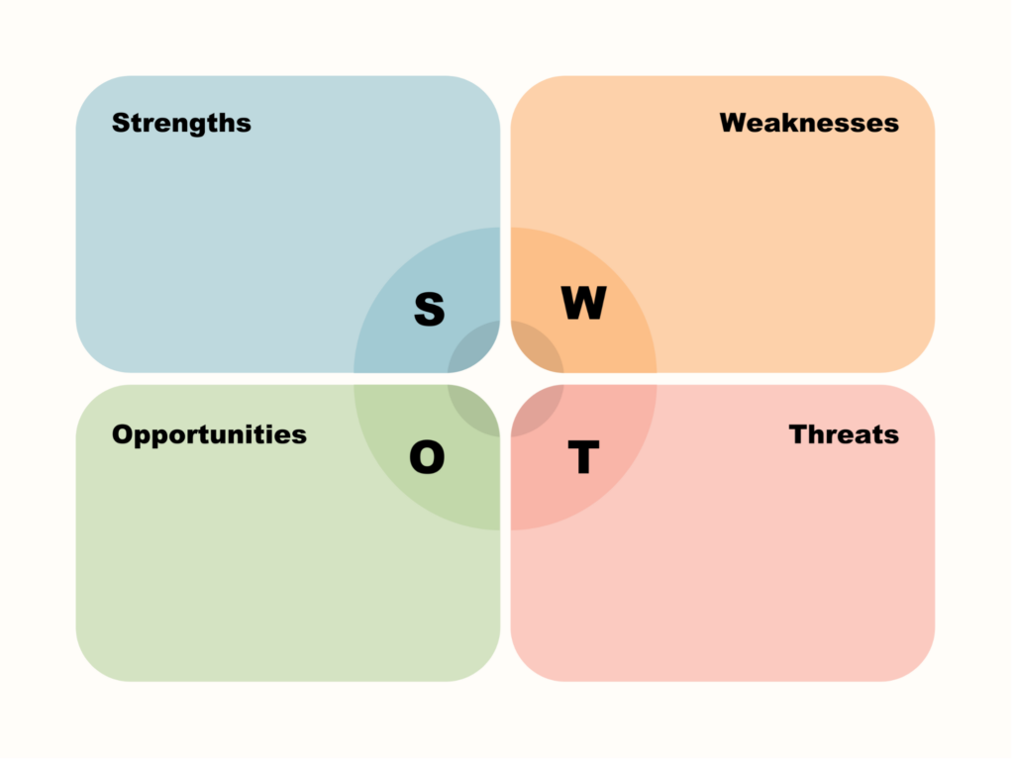
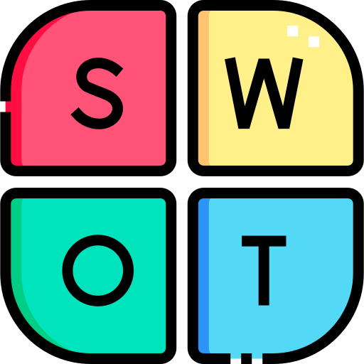
STRATEGIC POSITION OF BLACKBERRY
Security reputation
Brand trust
Software expertise
Reduced consumer presence
Outdated brand perception
Limited hardware ecosystem
Dominance of Apple & Google
Rapid innovation cycles
Competitive ecosystems
(statista, 2025)
Privacy concerns rising
Digital wellbeing trend
Desire for minimal tech

Slide 14
Industry Analysis: Why Reinvention Is Necessary
BlackBerry is in a very competitive mobile and digital ecosystem that is controlled by Apple and Google. Porters five force analysis was used in order to determine the possibility of a re-entry into the consumer space.
Force | Intensity | Industry Insight
Rivalry Among Existing Competitors | Very High | The smartphone and mobile OS market is dominated by integrated ecosystems such as Apple (iOS) and Google (Android). Competition is intense and innovation cycles are rapid.
Buyer Power | High | Consumers can easily switch between devices and platforms. Low switching costs increase pressure for strong differentiation.
Threat of Substitutes | High | Privacy tools, focus applications, and minimalist software solutions already exist within current smartphone ecosystems.
Supplier Power | Moderate | Hardware production requires large-scale manufacturing partnerships, increasing cost pressures and dependency.
Threat of New Entrants | Low in hardware / Higher in software | Hardware entry barriers remain high due to capital requirements, but privacy-focused software and applications are easier to develop and launch.
Conclusion: The direct competition in the traditional smartphone market (Red Ocean) is not strategically sustainable. Rather, BlackBerry can use Android compatibility and enterprise integration to gain entry to existing app ecosystems and position itself as differentiated by privacy-conscious design and digital well-being functionality.

Slide 15
Blue Ocean Strategy: Creating a Privacy-Focused Category
BlackBerry can redefine value as a result of focused differentiation rather than competing based on features or the scale of ecosystem.
Eliminate
Engagement-driven interface design
Default data harvesting models
Attention-maximizing app architecture
Reduce
Notification overload
App ecosystem complexity
Algorithm-driven content feeds
Raise
User control over data
Transparency of permissions
Focus-oriented design tools
This will shift BlackBerry off the existing smartphone competition to the establishment
of a new privacy-oriented category of mobile products.
Create
Integrated privacy dashboard
Distraction-free operating mode
Optional physical keyboard for intentional communication
Digital wellbeing-centered OS experience

Slide 16
Target Market Strategy & Revenue Logic
Segmentation
Market segmented based on psychographic and behavioral factors:
Privacy-conscious professionals
Students experiencing digital fatigue
Minimalist technology adopters
Enterprise employees requiring secure communication
Targeting
Primary target: 18–35-year-old professionals and students seeking greater digital control and reduced cognitive overload.
Positioning
BlackBerry: The privacy-first, focus-driven mobile device.
Revenue Model
Premium hardware sales
Monthly privacy subscription service
Enterprise bulk contracts
This structured targeting converts strategic differentiation into measurable revenue potential.
TAM / SAM / SOM Logic
TAM (Total Addressable Market): Global smartphone users concerned with privacy and digital wellbeing.
SAM (Serviceable Available Market): Users in North America and Europe actively seeking privacy-enhancing technology.
SOM (Serviceable Obtainable Market): Niche premium segment within 3 years through direct-to-consumer launch and enterprise pilot programs.

Slide 17

CORE VALUE PROPOSITION
Solution
BlackBerry reintroduces a focus-orientated smartphone with a privacy focus to help ease digital overload and bring control to purposeful use of technology.
Integrated privacy visibility
Intentional communication tools & Reduced cognitive overload
Optional physical keyboard
Security Meets Simplicity
User Outcome:
Focus • Control • Trust • Mental Calm
Secure operating system
Minimalist interface
BlackBerry transitions from a productivity device to a digital wellbeing platform rooted in trust.

Slide 18
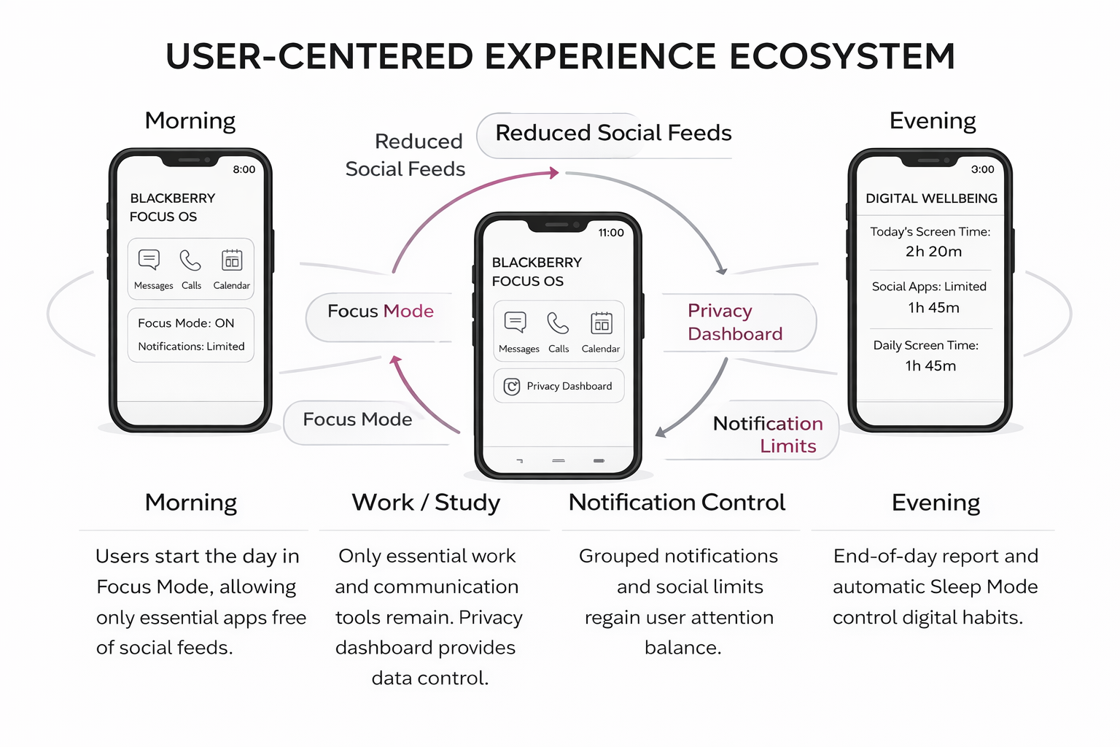

User-Centered Experience Ecosystem
This storyboard demonstrates how the BlackBerry redesigned experience helps users in critical situations of their daily lives. Instead of emphasising perceptions with notifications and algorithm-based feeds, the system encourages one to work, manage their data use, manage their communication, and enhance digital wellbeing.

Slide 19

ENVISIONED FUTURE STATE BY BlackBerry
Technology supports focus rather than interrupts it (George et al., 2023)
Privacy is integrated, not optional
Devices encourage intentional use
Further tech support:
  Fewer daily notifications
  Transparent data tracking visibility
  Controlled communication windows
  Reduced passive scrolling behavior
Users experience reduced digital stress (Godliauskas, & Šmite, 2025)

Slide 20

Reinvention Direction for BlackBerry
  The analysis shows that BlackBerry has a chance of repositioning as a privacy and digital wellbeing brand. As part of its security legacy and concentrated on simplified and controlled experience with technology, BlackBerry can respond to unmet user demands within the existing smartphone ecosystem.

Slide 21


Implementation Roadmap
  Develop a privacy-focused lifestyle device
  Emphasize security, focus, and minimalism
  Conduct user research on digital fatigue (Reuters, 2025)
  Prototype features: physical keyboard option, privacy dashboard, distraction-free modes (SunStar, 2024)
  Positioning theme: Security Meets Simplicity

Slide 22
REFERENCES
  Statista. (2026). BlackBerry – statistics & facts. Statista. https://www.statista.com/topics/5316
  SunStar. (2024). Dissecting the rise, fall of BlackBerry. https://www.sunstar.com.ph/cebu/lifestyle/dissecting-the-rise-fall-of-blackberry
  George, A. S., George, A. H., & Baskar, T. (2023). The death of analog: Assessing the Impacts of ubiquitous mobile technology. Partners Universal Innovative Research Publication, 1(2), 15-33. http://www.puirp.com/index.php/research/article/view/17
  Reuters. (2025, April 2). BlackBerry forecasts lower annual revenue due to weak demand for cybersecurity services. https://www.reuters.com/technology/blackberry-forecasts-lower-annual-revenue-due-weak-demand-cybersecurity-services-2025-04-02/
  Youssef, M. H., & Haj Youssef, M. (2013). Strategic tensions within the smartphones industry: the case of BlackBerry. VISTAS: Education, Economy and Community, 3, 125-141. https://westminsterresearch.westminster.ac.uk/item/967yy/strategic-tensions-within-the-smartphones-industry-the-case-of-blackberry
  Sexton, V., Dale, J., Bryce, C., Barry, J., Sellers, E., & Atherton, H. (2022). Service use, clinical outcomes and user experience associated with urgent care services that use telephone-based digital triage: a systematic review. BMJ open, 12(1), e051569. https://bmjopen.bmj.com/content/12/1/e051569.abstract
  Grieva, O., Guadamillas, F., Donate, M. J., & Appio, F. P. (2025). The digital, knowledge and innovation nexus: mapping synergies and charting a research agenda. Journal of Knowledge Management, 1-42. https://www.emerald.com/jkm/article/doi/10.1108/JKM-03-2025-0425/1308888
  Statista. (2025). BlackBerry revenue worldwide from 2004 to 2024 (in million U.S. dollars). Statista. https://www.statista.com/statistics/266240/blackberry-revenue/
  Massenon, R., Gambo, I., Ogundokun, R. O., Ogundepo, E. A., Srivastava, S., Agarwal, S., & Pak, W. (2024). Mobile app review analysis for crowdsourcing of software requirements: a mapping study of automated and semi-automated tools. PeerJ Computer Science, 10, e2401. https://peerj.com/articles/cs-2401/
  Shin, Y. (2025). Toward human-centered artificial intelligence for users’ digital well-being: Systematic review, synthesis, and future directions. JMIR Human Factors, 12(1), e69533. https://humanfactors.jmir.org/2025/1/e69533/
  Godliauskas, P., & Šmite, D. (2025). The well-being of software engineers: a systematic literature review and a theory. Empirical Software Engineering, 30(1), 35. https://link.springer.com/article/10.1007/s10664-024-10543-8
  Asurion. (2019). Americans check their phones 96 times a day. https://www.asurion.com/press-releases/americans-check-their-phones-96-times-a-day/
  Kaewpradit, K., et al. (2025). Digital screen time usage, prevalence of excessive screen exposure, and mental health outcomes. Frontiers in Psychiatry. https://www.frontiersin.org/articles/10.3389/fpsyt.2025.1535631/full
  Winter, H. (2024). The impact of screen time on ADHD symptoms in children and adolescents: A systematic review. https://pubmed.ncbi.nlm.nih.gov/41237171/

Slide 23
THANK YOU

